Slide 1
Occupational Specialist Component Content: Digital Production, Design and Development
The T Level T Level Technical Qualification in Digital: Digital Production, Design and Development includes a single Occupational Specialist Component. Therefore, there is a single synoptic assessment for the Occupational Specialist Component, which is an extended ‘design, development and implementation’ project. The synoptic element of the project is important in order to ensure that students are able to demonstrate threshold competence: this is the principal reason why the Occupational Specialism is assessed via a single extended project assessment to ensure that students are able to evidence all the skills required by the Performance Outcomes.
The T Level Technical Qualification in Digital: Digital Production, Design and Development Occupational Specialist Component consists of several activities grouped into four substantive tasks.
Each task will be completed during a window set by Pearson during which you will schedule supervised assessment sessions. In some cases, tasks will also involve opportunities for unsupervised activities where the requirements of the skills being assessed make this necessary.

Slide 2
The unit outcomes
1.6 Understand how to identify and be able to address personal training needs that can boost job performance during the software development process.
Considerations to ensure the software developer is able to complete the required solution:
identify what further knowledge is needed.
identify what new skills are needed.
determine if software developer has the ability needed to complete the required solution.
Use different methods to address personal training needs required to enable completion of project:
undertake coaching from a professional or peer.
learn new skills on the job.
carry out self-study.
use online professional forums.
sign up to internet workshops for additional training.

Slide 3
Learning Objectives
Aims:
To introduce Continuing Professional Development (CPD)
Objectives:
To be able describe Continuing Professional Development (CPD).
To be able to define the purpose and benefits of Continuing Professional Development (CPD).
To be able describe the different learning styles that are considered as part of Continuing Professional Development (CPD).

Slide 4


Continuing Professional Development (CPD)
Continuing Professional Development (CPD) is the term used to describe the learning activities professionals engage in to develop and enhance their abilities.
It enables learning to become conscious and proactive, rather than passive and reactive.
CPD combines different methodologies to learning, such as training workshops, conferences and events, e-learning programs, best practice techniques and ideas sharing, all focused for an individual to improve and have effective professional development.
There are over 1000 institutes & professional bodies across the UK.

Slide 5
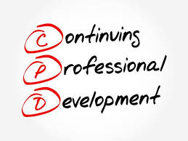
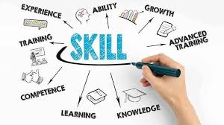
Continuing Professional Development (CPD)
Accompanied by such growth is the acceptance that academic qualifications must offer more vocational and skills-based or ‘practical’ learning.
A structured, practical and methodical approach to learning helps employers across industries to keep key staff and develop the skills & knowledge in their organisations to maintain a sustainable and competitive advantage.
Engaging in Continuing Professional Development ensures that both academic and practical qualifications do not become out-dated or obsolete; allowing individuals to continually ‘up skill’ or ‘re-skill’ themselves, regardless of occupation, age or educational level.

Slide 6
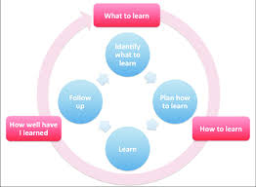
The Importance of Continuing Professional Development (CPD)
Continuing Professional Development is widely recognised as fundamental to the improvement of standards and skills for individuals and their industries.
Continuing Professional Development exists to ensure that an individual enhances their skills and abilities once they have formally qualified.
Typically, academic qualifications have already been completed at this stage and an individual is now working within their specific industry and job function.
CPD is important as it helps to ensure that further learning is progressed in a structured, practical and relevant way to guarantee that there are applied efficiencies in learning.
CPD allows an individual to focus on what specific skills and knowledge they require over a short-term period, say 12 months, in order to be confident there is recognisable improvement within their proficiency and skill sets.
“Education is not the learning of facts, but the training of the mind to think” – Albert Einstein.

Slide 7
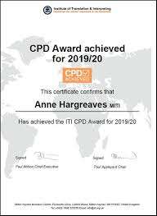
The purpose of CPD
In an ever-increasing globalised and competitive society, the importance of Continuing Professional Development cannot be overstated.
The world’s industries are forever evolving, which creates exciting opportunities but which also comes with challenges.
CPD enables an individual to regularly apply attention to important areas of development and takes appropriate action to reduce any shortfalls in knowledge.
Equally, an individual must see Continuing Professional Development as a way to remain competitive with his or her peers, and as an opportunity to differentiate themselves at moments where this may be required, such as in job interviews or in tenders for new work and business acquisition.

Slide 8
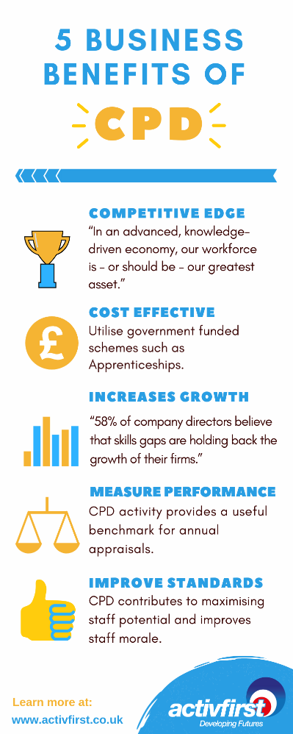
The purpose of CPD
As more people become professionally qualified with similar qualifications, CPD becomes more important as a means of separating yourself from the pack.
A planned approach to Continuing Professional Development allows an individual to put themselves in charge of their own career development and work-related ambitions.
A personal empowerment of learning brings with it an increase in confidence and resulting abilities, all of which correlate to an improvement of capability for their employment environment.

Slide 9
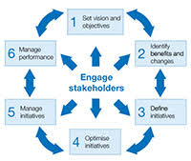
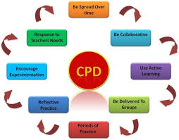
What are the benefits of CPD?
Continuing Professional Development is essential in helping individuals, organisations or entire industries to keep skills and knowledge up to date.
Providing CPD enables organisations to become a knowledge bank to key stakeholders of your organisation.
CPD accredited training courses, workshops and events allow professionals to use the learning time towards individual CPD requirements.

Slide 10

What are the benefits of CPD for individuals?
Continuing Professional Development helps individuals to regularly focus on how they can become a more competent and effective professional.
Training and learning increase confidence and overall capability, and compliments career aspirations.
CPD enables individuals to adapt positively to changes in work/industry requirements.
Planning CPD helps to be more efficient with time, and recording CPD properly provides evidence of professional development (this can be useful for supervision and appraisals).
CPD shows a clear commitment to self-development and professionalism.
CPD provides an opportunity for an individual to identify knowledge gaps and to resolve these in a recognisable approach to improvement.
Accredited CPD Providers should make available to individuals a Certificate of Attendance to attach to their CPD log as evidence of development once training is complete or the desired standards of learning have been met.

Slide 11

What are the benefits of CPD for organisations?
Providing CPD accredited learning benefits your organisation through recognition and increased brand perception.
Internal use of Continuing Professional Development encourages and promotes a healthy learning culture for your organisation, leading to a more fulfilled workforce and retaining valuable staff.
Many organisations have staff with CPD obligations as members of professional bodies.
In circumstances where internal CPD training resources are low, organisations use outsourced CPD training providers to meet staff requirements. Outsourced CPD providers are typically training companies, online learning resources, events & conference organisers.
They are experts in their field and provide practical learning opportunities through CPD events, seminars and accredited CPD courses.
Some CPD courses are just 1 or 2 hours long, delivered in a seminar or classroom-style environment.
Other accredited CPD courses can be a full 6-10 weeks program, split into structured bite-size modules.

Slide 12
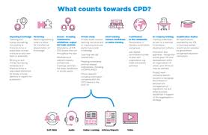
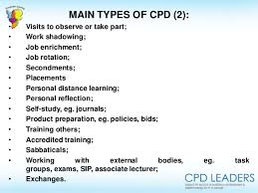
CPD Learning Types
Types of CPD learning vary significantly, depending on the requirements for your business, or if you’re learning as an individual.
There are 3 types of learning:
Structured CPD / Active Learning
Reflective CPD / Passive Learning
Self-Directed CPD / Unstructured Learning

Slide 13

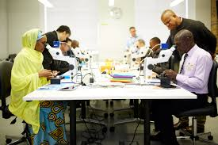

Structured CPD / Active Learning
This type of learning involves interactive and participation-based study.
It is typically proactive and can include attending a training course, conference, workshop, seminar, lecture, e-learning course or CPD certified event.
CPD active learning also applies to when professionals take career orientated exams and assessments (the study and revision would be considered self-directed learning, see Self-Directed CPD).

Slide 14


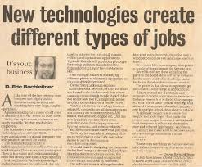
Reflective CPD / Passive Learning
This type of learning involves no participant-based interaction, so this form of CPD is much more passive and one directional.
Examples of this include reading relevant news articles, podcasts & case studies and industry updates.
Some informal meetings can be applicable to CPD reflective learning, but the learning objectives of these meetings must be made clear in an individual’s overall CPD plan.

Slide 15
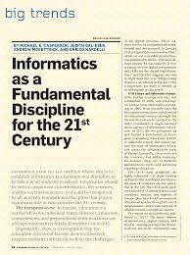



Self-Directed CPD / Unstructured Learning
This type of learning involves all unaccompanied CPD activities.
It covers the reading of documents, articles and publications; either in print or online.
Reading relevant publications, books by leading experts, industry journals and trade magazines are all types of self-directed CPD.
You could also include industry-specific news feeds or research into relevant fields.

Slide 16
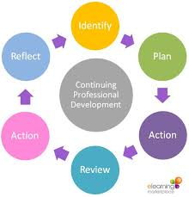
Activity
Identify all the current Continuing Professional Development (CPD) activities you presently undertake.
Create a table which lists all your CPD activities.
Highlight which learning style category they belong to.

